Slide 1

APAC HPC-AI COMPETITION
Team Monash DeepNeuron
Notes:
10

Slide 2
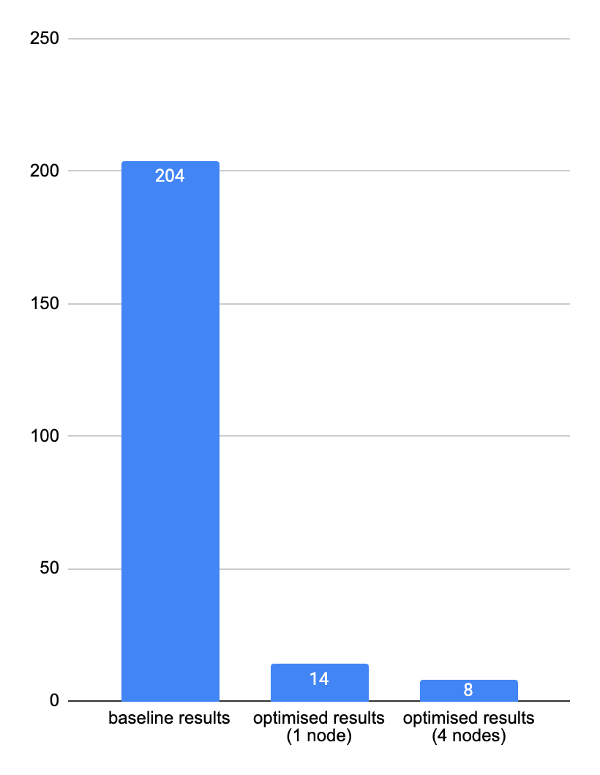
FINAL RESULTS
Compiler | intel -compiler-llvm/2025.2.0
Math Routine | intel- mkl/2025.2.0
ARMCI Network | MPI-PR
MPI | intel-mpi/2021.16
Optimised 4 node performance: 8~s
Optimised 1 node performance: 14~s
Notes:
Say these are the optimal settings we found through various testings

Slide 3
SCIENTIFIC METHODOLOGY
Multivariate Testing vs inode quota limits
Wrote scripts to reduce inode usage
Data Collection vs KSU quota limits
Conducted sampling via intel-mpi gtool flag
mpirun -np $TOTAL_RANKS \
-ppn $RANKS_PER_NODE \
-genv OMP_NUM_THREADS $OMP_NUM_THREADS \
-genv OMP_PLACES cores \
-genv OMP_PROC_BIND close \
-gtool "vtune -collect hotspot -r vtunehot:0" \
$APP $INPUT > $OUTPUT
$ find ./nwchem | wc
31288 31288 1266694
$ ./clean.sh nwchem
...
$ find ./nwchem | wc
2122 2122 83615

Slide 4
COMPILATION SETTINGS
# COMPILER FLAGS
export FCFLAGS="-Ofast -march=sapphirerapids -fp-model fast=2 -fopenmp \
-i8 -fPIC -ipo -fallow-argument-mismatch \ -fno-operator-overloading-check"
export CCFLAGS="-Ofast -march=sapphirerapids -fp-model fast=2 -fPIC -ipo"
export CXXFLAGS="-Ofast -march=sapphirerapids -fp-model fast=2 -fPIC -ipo"
# ARMCI SETTINGS
export ARMCI_NETWORK=MPI-PR
export EXTERNAL_ARMCI_PATH=$NWCHEM_TOP/external-armci
# GLOBAL ARRAY CONFIGURATION
# export EXTERNAL_GA_PATH=$GA_INSTALL
Notes:
Special flag for Fortran
ofast for fast
Armci was just better
Global array optimisation didn’t work (comex backend was better)

Slide 5
CONVERGENCE DIFFERENCE
$ diff optimised_results.nwout baseline.nwout
35,39c35,39
< Total DFT energy = -917.738247953118
< One electron energy = -3287.432508164322
< Coulomb energy = 1466.414001922894
< Exchange-Corr. energy = -112.235614418838
< Nuclear repulsion energy = 1015.515872707148
---
> Total DFT energy = -917.738244976750
> One electron energy =
> Coulomb energy =
> Exchange-Corr. energy =
> Nuclear repulsion energy = 1015.516447774855
Notes:
we are within the threshold tolerance of 10^-6
We suspect that this is because nwchem implements its own algorithms for matrix multiplication and integral evaluation, so the precision is not as susceptible to changes in compiler settings.

Slide 6
MPI DIRECTIVES
Multithreaded open-mpi
Pure MPI
intel-mpi
mpirun -np $TOTAL_RANKS \
--map-by ppr:$RANKS_PER_NODE:node:PE=$OMP_NUM_THREADS \
--bind-to core \
--report-bindings \
$APP $INPUT > $OUTPUT
mpirun -np $TOTAL_RANKS \
-ppn $RANKS_PER_NODE \
-genv OMP_NUM_THREADS=$OMP_NUM_THREADS \
-genv OMP_PLACES=cores \
-genv OMP_PROC_BIND=close \
-genv I_MPI_PIN=1 \
-genv I_MPI_PIN_DOMAIN=core \
-genv I_MPI_MAP_BY=node \
$APP $INPUT > $OUTPUT
Notes:
These bindings are the default and they are good because we are using a pure-mpi mixture, so most communication is happening through ucx anyways (numa doesn’t help because thats omp)

Slide 7
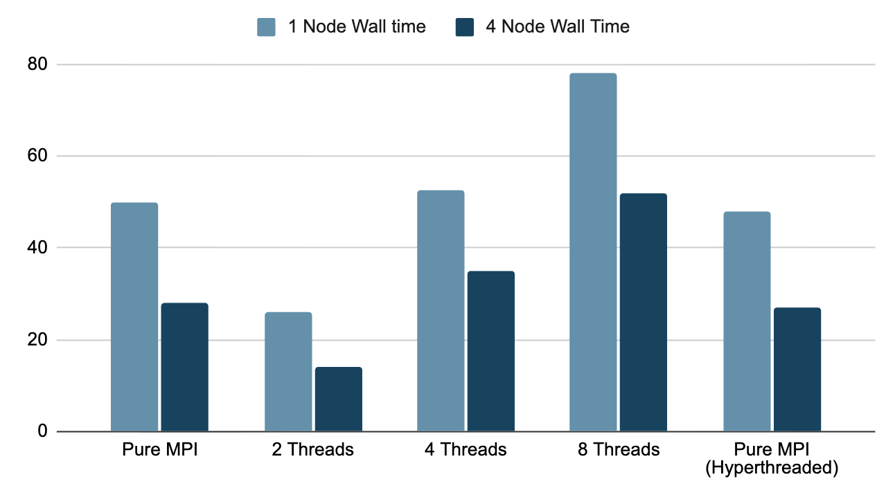
OPENMP MULTI/HYPER THREADING
Notes:
Hyperthreading did not work because the larger number of threads meant more startup time

Slide 8
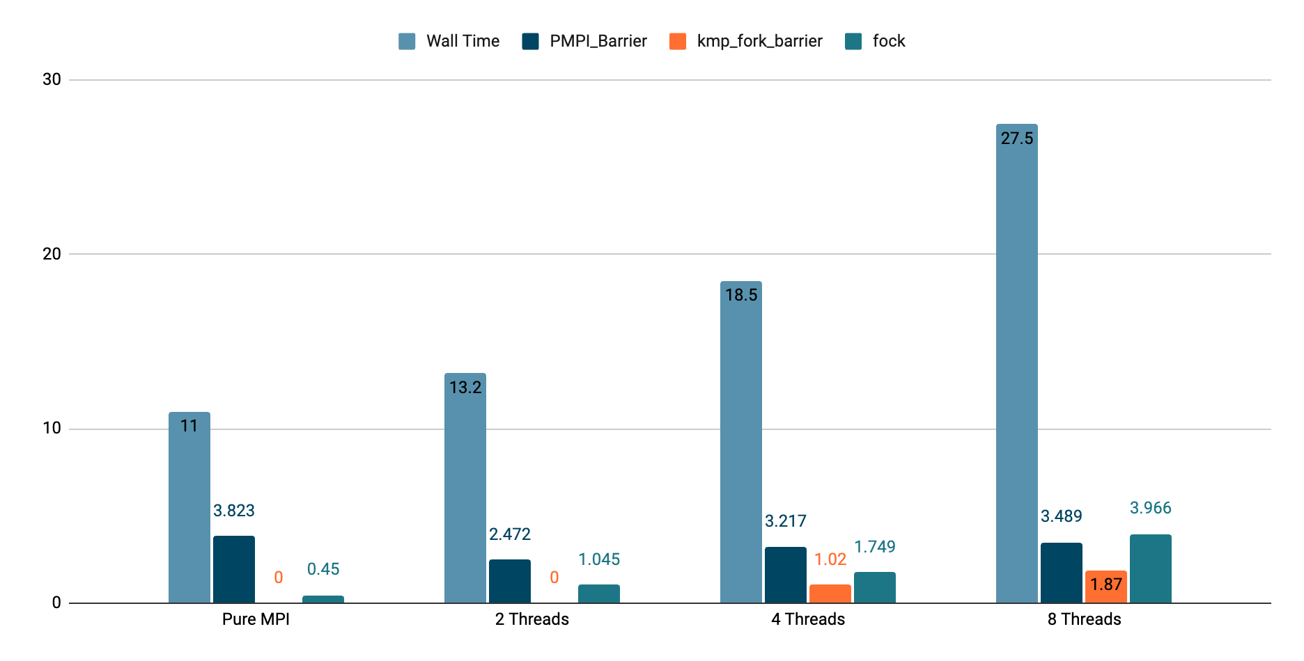
INTEL-MPI THREADING ANALYSIS
Notes:
These numbers aren’t the best because we are running profiling (even with just 1 thing being profiled)
Pure mpi is the best
kmp fork is to do with overhead of starting up threads
Fock is to do with matrix multiplication (nwchem’s implementation of

Slide 9
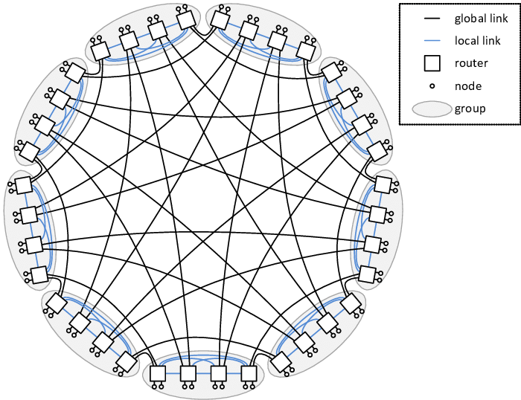
UCX (INFINIBAND)
export UCX_TLS=rc_x,dc_x,ud,self,sm
export UCX_NET_DEVICES=mlx5_0:1
export UCX_MEMTYPE_CACHE=n
export UCX_RNDV_SCHEME=get_zcopy

Slide 10
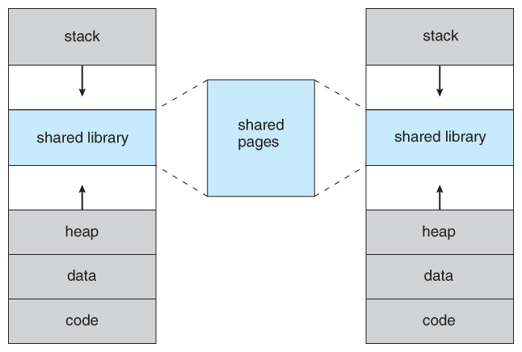
MEMORY ALLOCATION
< memory stack 1100 mb heap 100 mb global 1100 mb

Slide 11
DFT/SCF CHANGES
$ diff optimised_results.nwout baseline.nwout
< memory stack 1100 mb heap 100 mb global 1100 mb
---
> memory stack 8000 mb heap 100 mb global 8000 mb noverify 6,7c7,8
< permanent_dir .
< scratch_dir /tmp
---
> permanent_dir .
> scratch_dir /tmp
51a53,66
>
53c68
< semidirect
---
> direct # you can change this
Notes:
Didn’t need to change thes scratch dir for storage because it already uses good hardware (need to remember what the hardware was). NCI literally said that /scratch dir is their fastest i/o one

Slide 12

Notes:
Into: Cuda changes

Slide 13
CUDA API VERSION
We found that through Conda we could download different Cuda API’s, and experiment with which was fastest. We found that Cuda129 was the fastest, showing 7863.04 tokens per second on 2 H100 nodes compared to 5839 tokens per second on Cuda126 on 2 H100 nodes
This is likely because Sglang is able to use the newer cuBLAS and DeepGEMM kernels that are compatible with the newer SGLang versions.
34% Faster!
Notes:
Into: DeepGEMM compilation and explanation

Slide 14
DEEPGEMM
Using DeepGemm JIT compilation with SGLang will improve throughput, it’s worth noting that DeepGemm JIT Compilation is enabled by default in SGLang so I haven’t added any flags for it, though it will cause the first run of our scripts to take significantly longer (~10-20 mins) as the DeepGemm JIT kernels are pre-compiled.
Others have included scripts that are dedicated to performing this JIT DeepGemm kernel pre-compilation, but we have elected to allow SGLang to do it on the first run to remove unnecessary complexity when attempting to run our builds for the first time.
This error message implies you need to run the sglang.compile_deep_gemm command to pre-compile the kernels, this is not the case.
Notes:
Into: Singularity vs Python Venv launch

Slide 15
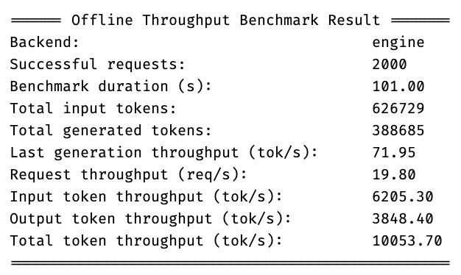
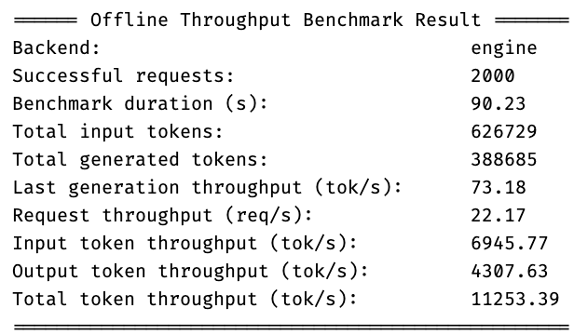
LAUNCHING SGLANG
Python Venv Launch
With Singularity
Notes:
We found that we could launch SGLang through Singularity, or directly through a python venv. When installing packages through Pip we chose to use UV, we also used UV to manage our Venv too, as this increased efficiency for package installation and allowed for easier cuda version and torch version swap outs without complete reinstallation.
Additionally, we found that launching through Singularity had a dramatic increase in throughput when compared with through a python venv, pictured to the left.
Results from Firmus SMC Cluster.
Into: Parallelism techniques

Slide 16
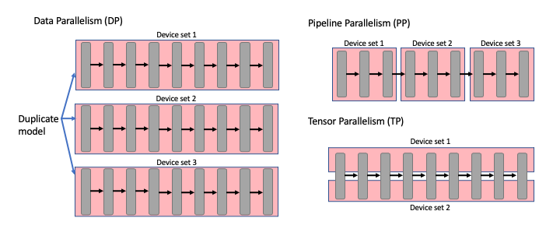
PARALLELISM TECHNIQUES
Notes:
TP: Splits the model layers in half, splitting them between the GPU’s
DP: Creates copies of the model in multiple locations, gives half the prompts to each model instance best for minimising communication overhead
PP: Splits the model itself so that each layer or series of layers is held a different GPU
Next: Batch Size

Slide 17
PARALLELISM WIN: BATCH SIZE
Experiments ran where the number of prompts was less than the 2000 showed a significant decline in offline throughput, for example our best results showed ~17k token’s per second, if we were to half the number of prompts to 1000 prompts, we would see ~10k token’s per second, a drop off of nearly half!
This made it clear that maximising the batch size of our program would maximise throughput, as this would ensure that the KV Cache remained saturated and that the GPU’s parallelism capacities were maximised.
Notes:
Maximise batch size
Ensure KV Cache remains saturated
Into: Single Node, pros, cons, and communication

Slide 18
SINGLE NODE THROUGHPUT
We found that running deepseek R1 on one node significantly reduced communication overhead, such that the advantages that can be achieved from using 2 nodes (extra gpu memory and processing power) where nearly trumped by the disadvantages of using 2 nodes (primarily greater communication overhead). During our investigations into this issue, many pointed out that it may have been that we were not fully utilising both nodes, this led us to perform some profiling.
We found that profiling SGLang’s running at 2000 prompts was difficult, but if we dropped the number of prompts be used then the performance was not comparable due to different bottlenecks arising to the full number of prompts. Profiling at 2000 prompts would lead to massive profiling files (~8gb per GPU), so we were left with the next best option which was monitoring GPU, CPU, and RAM utilization live, through tools like HTop and NVTop.
Notes:
Into: Profiling with nvtop, htop

Slide 19
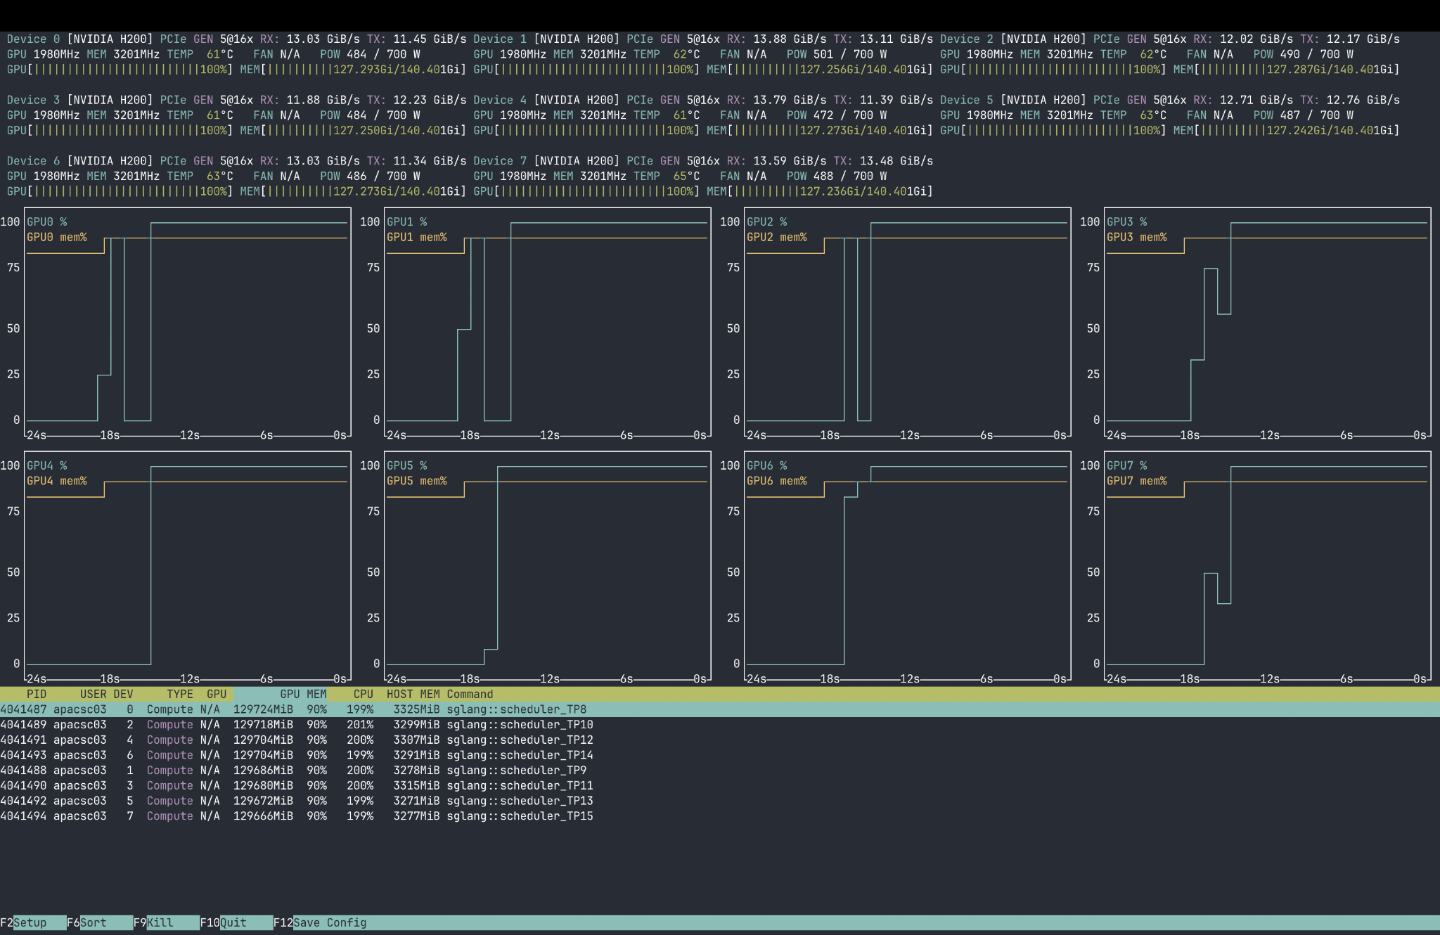
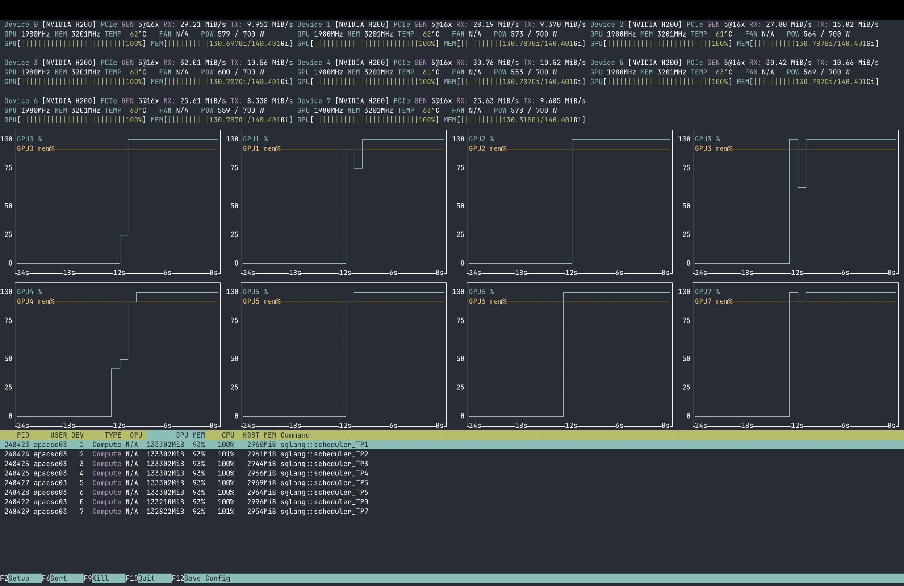
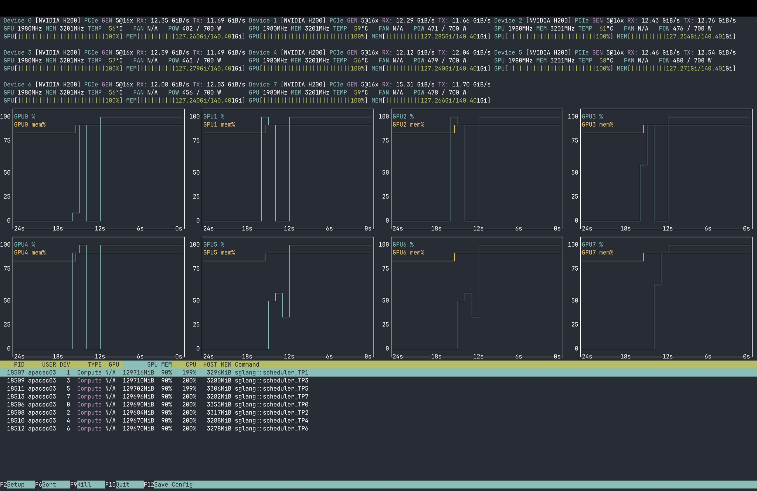
PROFILING RESULTS
2 Node Deployment, 11,381.11 Tok/Sec
Single Node Deployment, 12,520.75 Tok/Sec
With baseline two node script as provided in run scripts (TP = 16, Direct python launch)
With TP = 8 and default python direct launch as iterated in provided run scripts.
Notes:
We found that our issues around 1 node throughput being faster than 2 node throughput where indeed due to large communication overheads, from the images shown, it is clear that both nodes are near 100% utilization during a 2 node deployment, as is the singular node during 1 node deployment.
Into: pre/post tuning results

Slide 20
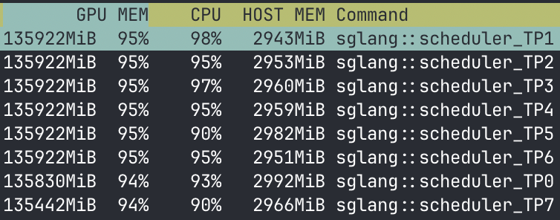
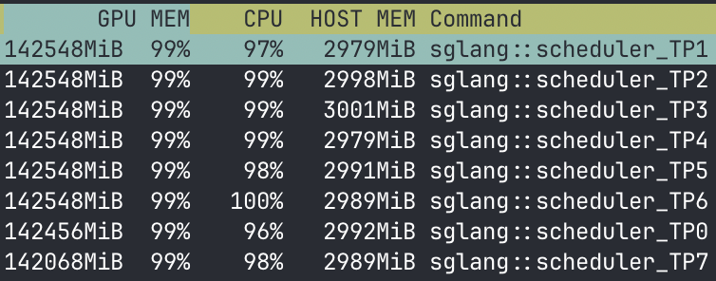
PRE/POST TUNING
Before Tuning
After Tuning
Notes:
From this profiling, we were able to see that the memory utilization from all GPU’s was not at 100%, this led us to analyze different ways to most efficiently utilize all of the resources on each node, through this analysis we determined that modifying the mem-fraction-static parameter led to the largest increase in throughput, along with modifying the cuda-graph-max-bs parameter which modified the cuda graph maximum batch size.
This led to use going from memory utilization ~94% to consistently hitting 99% through the mem-fraction-static modifications.
Pictured to the right is a before tuning and after tuning image depicting the increase in memory utilization we were able to achieve.
Into: batch size, memory fraction static comparisons

Slide 21
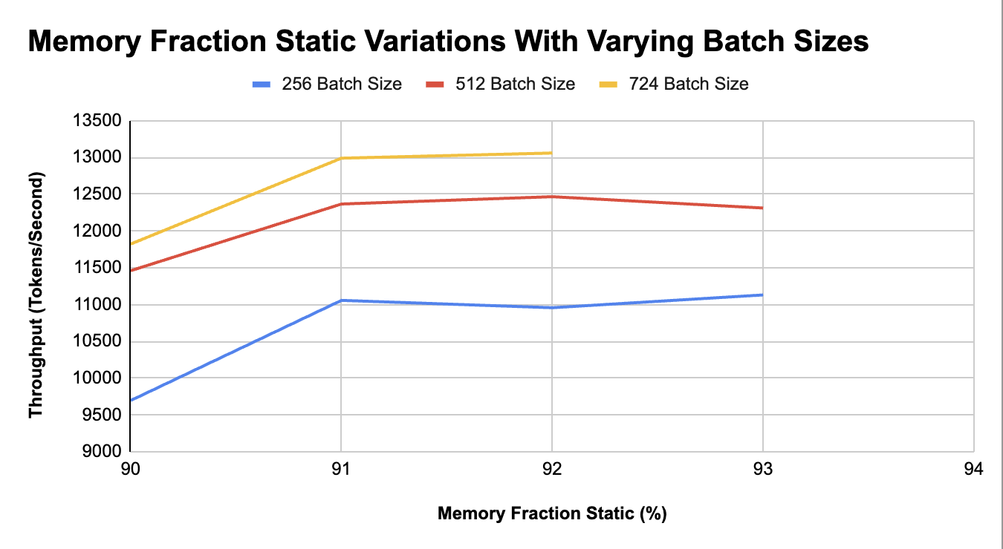
BATCH SIZE THROUGHPUT RESULTS
CUDA OOM occurs after Line stops.
Notes:
Memory Fraction Static modifies KV Cache to maximise KV Cache pool

Slide 22
NETWORK TOPOLOGY
Nodes are connected through infiniband and RoCE v2, though Infiniband is primarily what we used. Internally each gpu is connected to each other through NVLink.
When attempting to optimise the network configuration for NCCL there are numerous parameters that can be optimised, we chose the ones we believed would make the largest performance improvements and experimented with those, on the next slide are our results from tuning those.

Slide 23
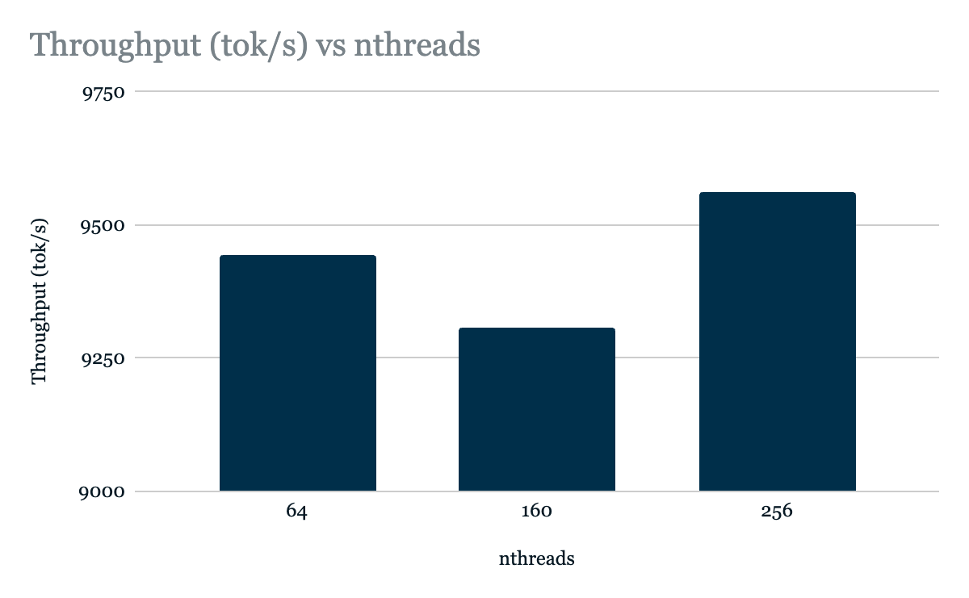
Notes:
Max num threads for NCCL Communication
the threads are grouped into blocks of streaming multiprocessors. the size of these blocks are usually power of 2.
we see better results for 64 and 256 because they utilise the full blocks assigned to them. by contrast the 160 thread version runs a lot worse. Our tentative explanation/hypothesis is that the 160 thread run incurs the extra overhead of utilising more blocks (i.e. inter block communication and/or initialisation costs) without fully obtaining the benefits of using said blocks

Slide 24
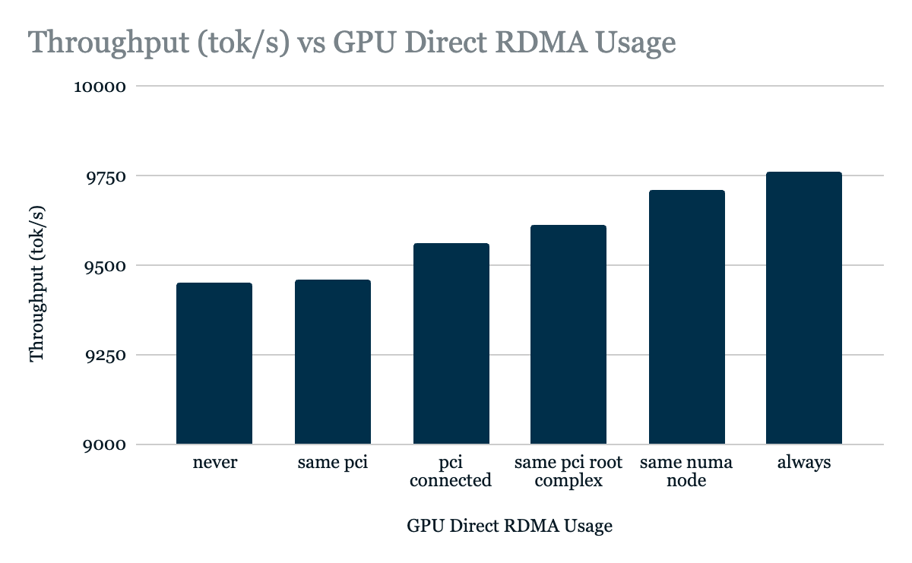
Notes:
GPU Direct Modifications
Setting the NCCL_NET_GDR_LEVEL allows us to specify when the GPU Direct RDMA is used.
We observe that in general this networking path is faster than the alternatives, so by specifying that we should always use RDMA, we achieve the highest level of throughput

Slide 25
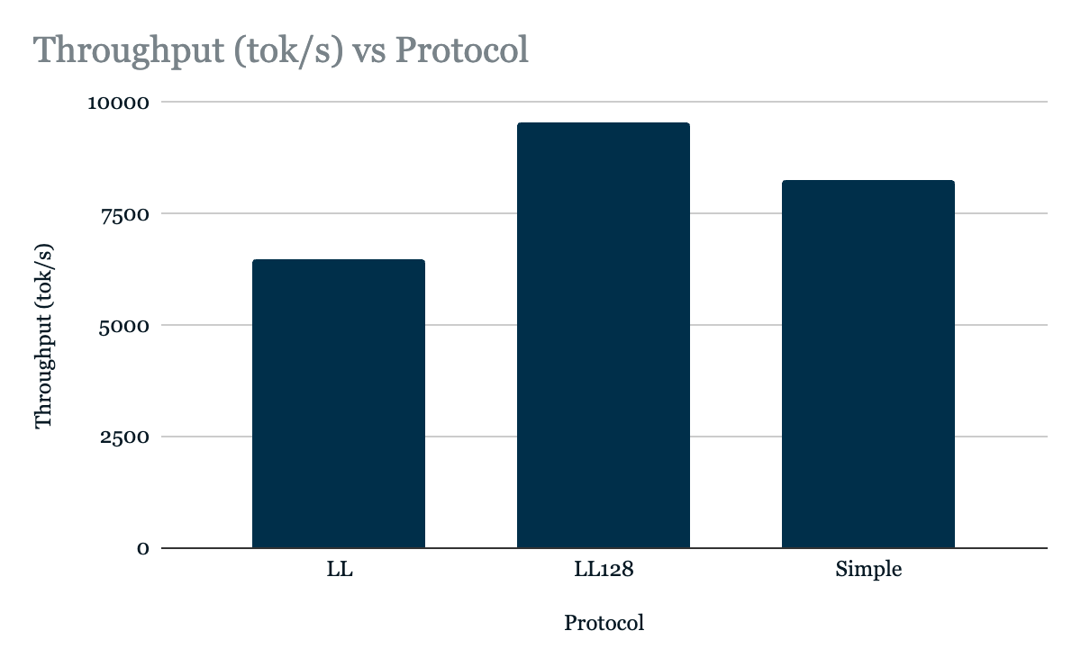
Notes:
LL (Low Latency) protocol prioritizes fast, small messages using flag-based synchronization, while
Simple focuses on maximum bandwidth for large messages using high-overhead memory fences.
LL128 mixed both approaches, but relies on particular hardware to be efficient. We found that firmus supports the necessary

Slide 26
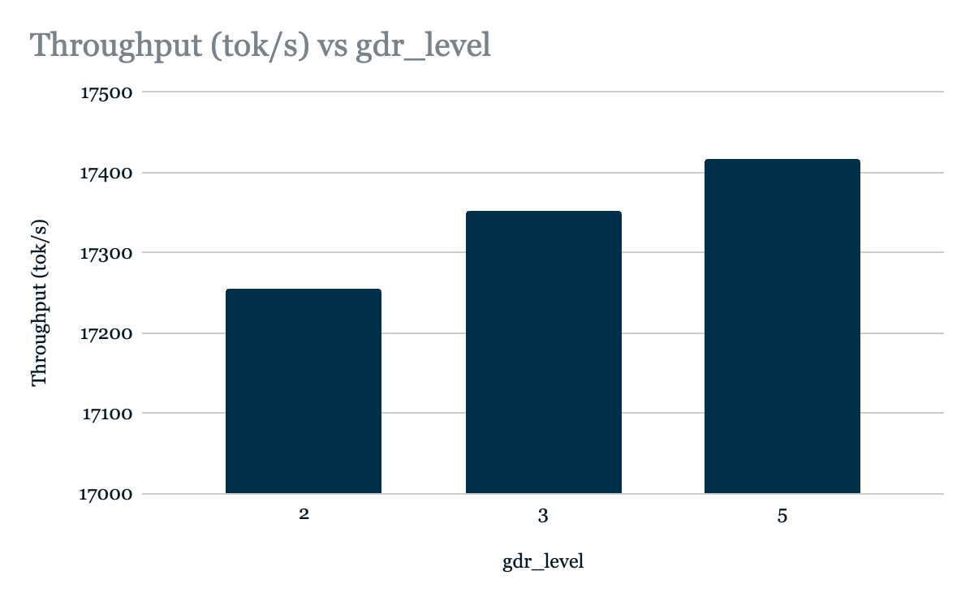
Notes:
GDR_Level the maximum distance gpu direct can be used between a network interface and the gpu,
For our purpose this effectively maximizes the SGLang’s GPUDirect usage.
3 is default, 5 is what we have chosen
Into: Parallelism Techniques continued

Slide 27
PARALLELISATION TECHNIQUES CONT.
I stated earlier that Data Parallelism (DP) is king for throughput, however true DP across two nodes in sglang is not available in the form of an offline benchmark, however through online serving and benchmarking that we are able to perform true DP.
This has a large caveat though, it draws in many more required operations (load balancing, proper tokenization…) and most importantly does not satisfy the criteria for this competition to benchmark offline throughput.
I attempted it anyway, and found that the results were ~16k tokens per second. In a real deployment scenario, we propose this as the most practical method for deploying DeepSeek R1.
Notes:
Data parallelism is best for fixing our communication problems
Data parallelism across nodes is not available in the form of our offline benchmark
Into: Parallelism Techniques Table

Slide 28
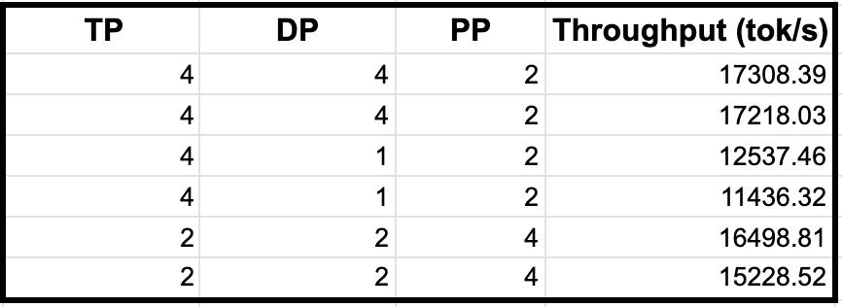
FUTURE CONSIDERATIONS
Our current issue:
Cross node deployment has too much communication overhead
The Parallelism technique most adapt to fixing this is not present in SGLang when performing offline benchmarks across nodes
So we optimised for one node, we found that the optimal configuration was TP = 4, DP = 4, PP = 2, with dp-attention.
The TP == DP is a requirement for dp-attention, which speeds up the attention heads within the node, and allows for SGLang’s shared experts (EP) optimisations.
The PP=2 helps reduce unnecessary communication within the node, and increases KV-Cache locality between the GPU’s.
Notes:
Tensor Parallelism = Data Parallelism for shared attention heads
Pipeline Parallelism reduces unnecessary communication within the node
Into: best one node parallelism settings

Slide 29
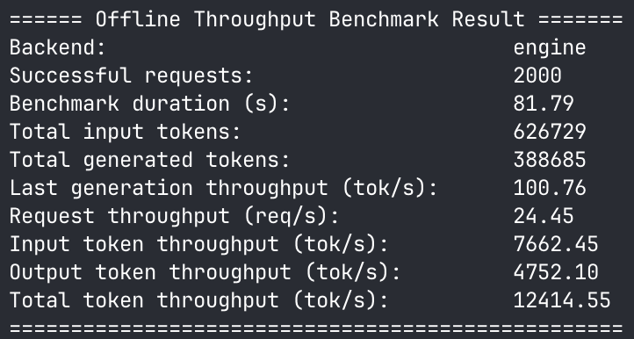
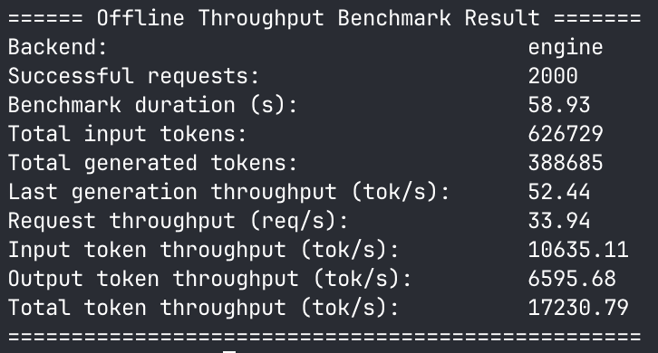
PARALLELISM ANALYSIS
TP=8
+40% Throughput Increase from just parallelism configuration changes
+75% Throughput Improvement Over Provided Baseline
TP=4, DP=4, PP=2, DP-Attention
Notes:
Into final results

Slide 30
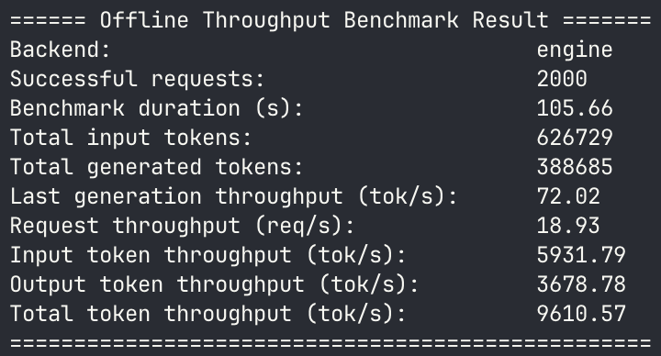
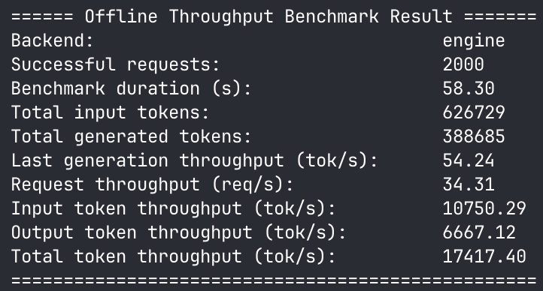
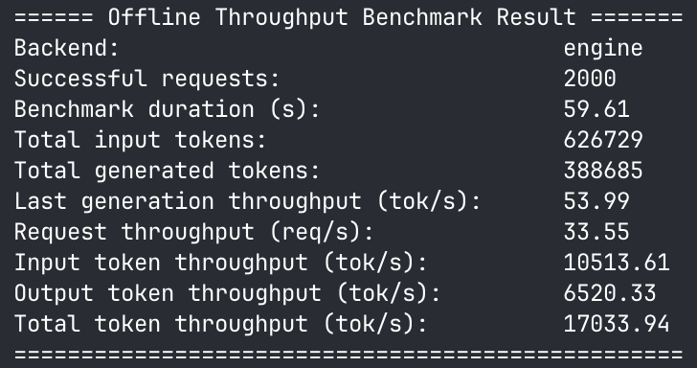
FINAL RESULTS
Baseline
+82% Throughput Improvement Over Provided Baseline
One Node Best
Two Node Best
Notes:
Into: our recommendations for the actual deployment

Slide 31
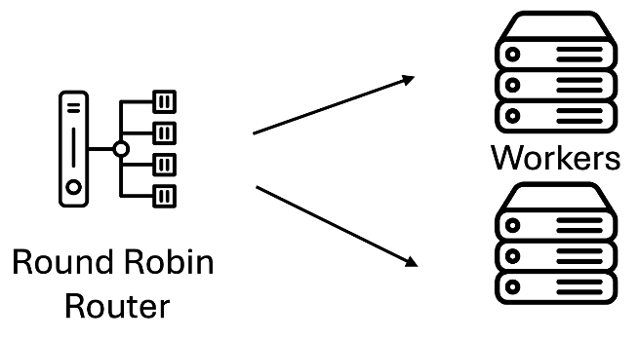
ACTUALISED DEPLOYMENT
In a real world deployment, we propose using a router worker architecture, as shown below. In this scenario, each node would run an instance of a SGLang’s DeepSeek worker.
Notes:
This would effectively provide the cross node data parallelism that we talked about earlier, though this would be online inference so not valid for this competition. Our initial experimentation with this showed great results, providing ~16k tokens per second.
Into: additional considerations and modifications

Slide 32
ADDITIONAL CONSIDERATIONS
Here are some additional features/options we implemented or experimented with.
Torch Compile
Nsight Profiling with less prompts
Direct DeepGEMM pre-compilation (no difference compared to current precompilation method)
Expert Parallelism (implemented by default with current setup)
MTP Multi Token Prediction
Hyperparameter Optimisation With NN (too inefficient, uses too many resources)
Attention Backend Swap Outs
And many other things!
Notes:
Into: Done

Slide 33
Thanks For Listening!
Team Monash DeepNeuron
Notes:
10

